Slide 1
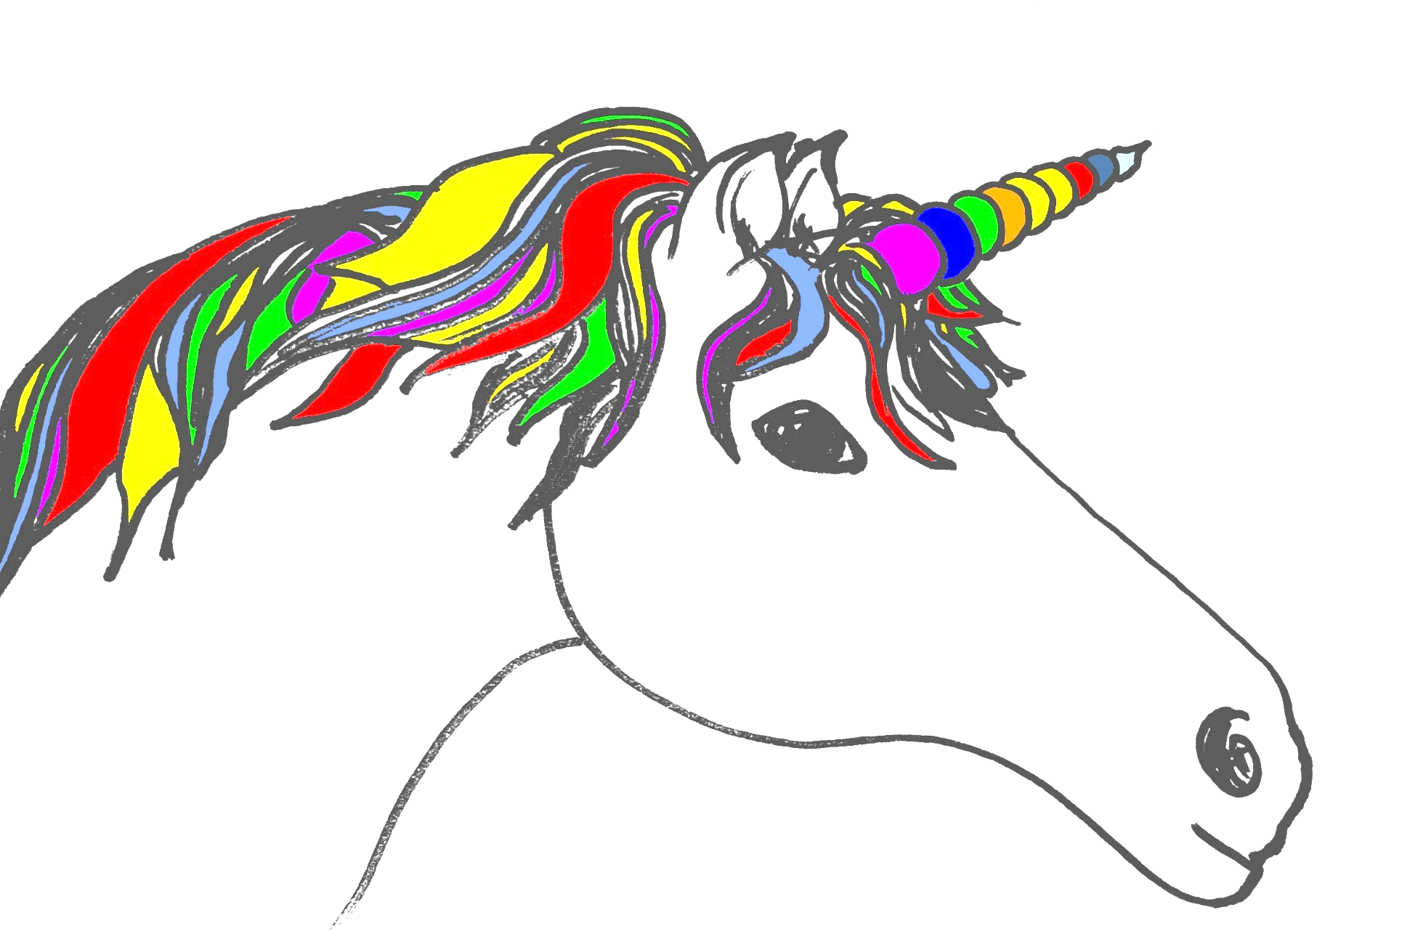

DevOperability
Alex Moore
System Build Engineer
Transunion UK (Formerly Callcredit)
Twitter @smileandeliver
GitHub https://github.com/smileandeliver/
Notes:
DevOps Engineer / Deployment Monkey / Ex IT, Ops, Support, Marketing …

Slide 2

“Testing Is DevOps”
@smileandeliver

Slide 3
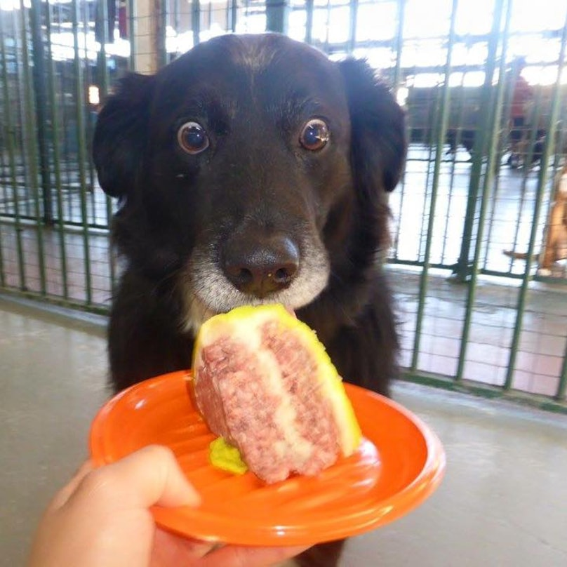
DevOps
In
Five…
Notes:
Let SOPHIE talk to you all about DevOps in half an hour’s time but just to give some context for this talk, here’s five minute devopsy goodness. Going to start with the CALMS model

Slide 4
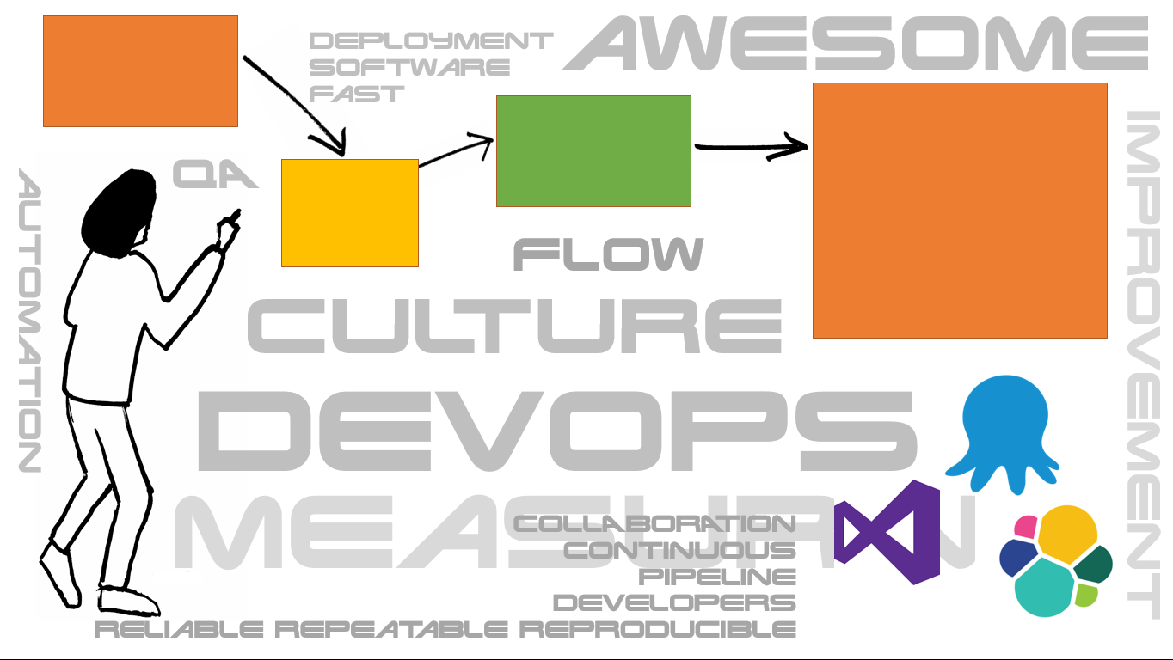
C
A
L
M
S
CULTURE
@smileandeliver
Notes:
Enabling people to do awesome stuff!

Slide 5

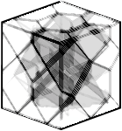
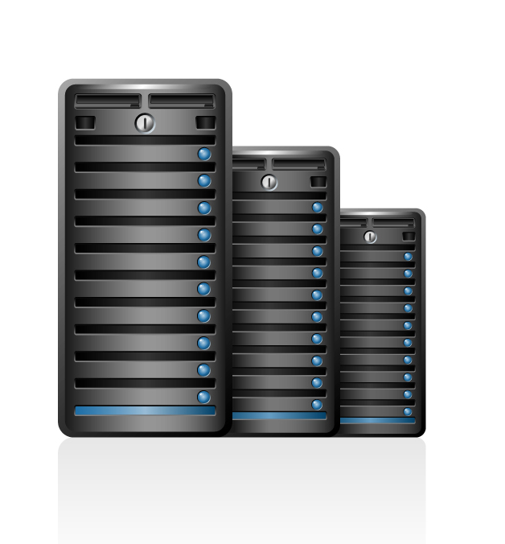



C
A
L
M
S
AUTOMATION
@smileandeliver
Notes:
Easy with DevOps coz you get a Pink fluffy unicorn to just magically take you components into production!! Really automation is a LOT of work but you automate the repetitive and the boring stuff so human beings can concentrate on AWESOME stuff

Slide 6
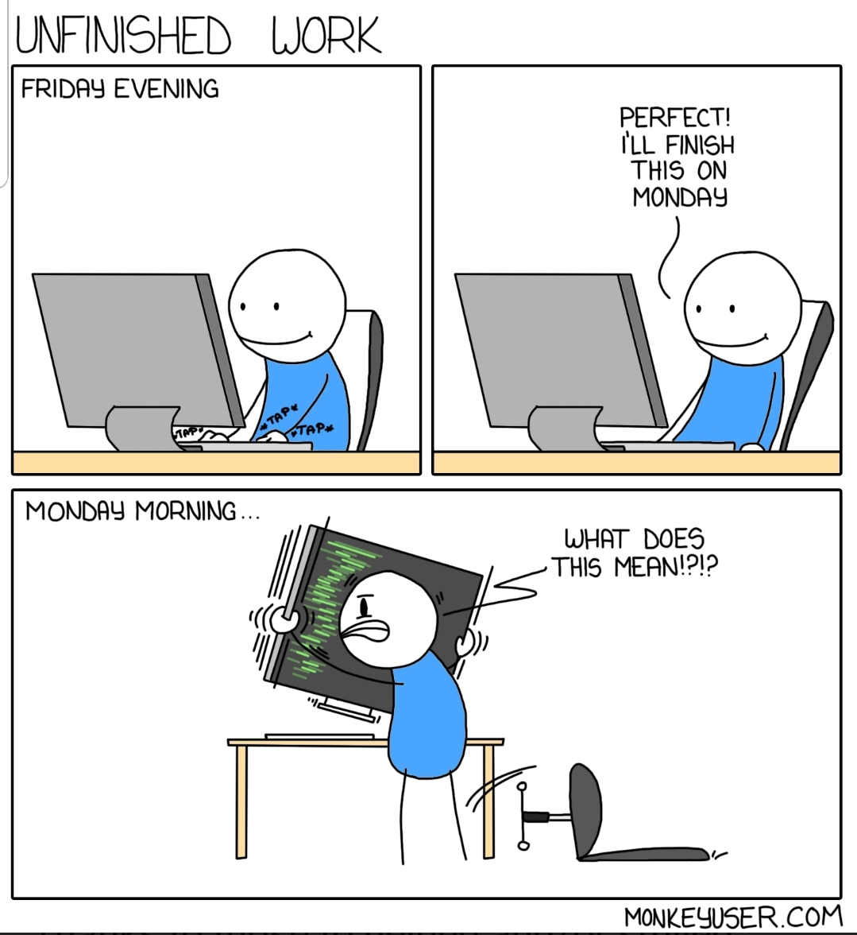
C
A
L
M
S
LEAN
Notes:
Create the awesomeness in small batches and get them submitted and tested fast!
Map out and understand the whole value stream from the awesome idea to where the awesomeness can be enjoyed by the end users

Slide 7

C
A
L
M
S
MONITORING
Notes:
How awesome is it? Awesome!!

Slide 8
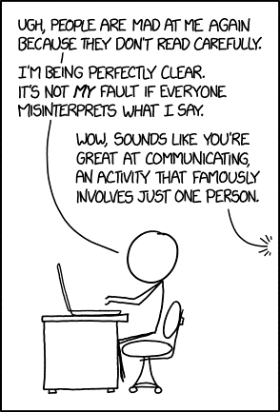
C
A
L
M
S
SHARING
Notes:
Communicate, learn, shout about it, be honest. It’s Awesome.

Slide 9


Dev
Ops
Dev
Ops
Dev
Ops
@smileandeliver
Notes:
Three ways! Talk thro real briefly

Slide 10



Three Ways of DevOps
God
Reporter
Genius
@smileandeliver
Notes:
See the three ways as three different personalities and by imagining yourself as that character you can reimagine anything and everything that you dp

Slide 11

Gods
The First Way
Systems Thinking
The Second Way
Reporters
Amplify Feedback Loops
The Third Way
Geniuses
Culture of continual experimentation and learning
@smileandeliver
Notes:
In DevOps, you need all three of these for success!
Don’t be too tied down by these definitions – just let the ideas for improvement as they occur to you.

Slide 12

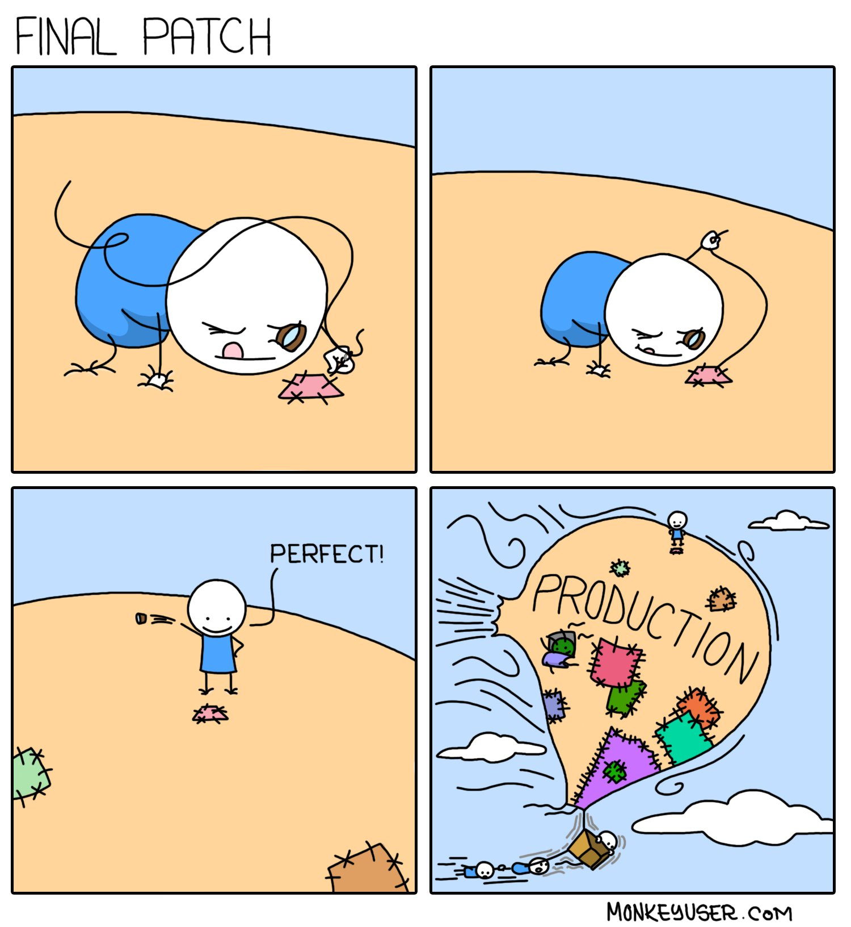
@smileandeliver
Notes:
Brass tacks – Operability. First let’s look at Where we are going wrong. We can put out something that passes all its software and functional testing but which is a nightmare waiting to happen.
DevOps is not about taking responsibility for EVERYTHING that happens in the entire pipeline, it’s about everyone working seamlessly with shared knowledge and understanding – so with Testing in DevOps as well, you don’t need to do it ALL YOURSELF. Maybe you will become an Operational Testing guru. Maybe you’ll have a different niche – but mainly if you have the right awareness of Operability, you then have the power to make sure that *someone* is doing it! All across the DevOps movement, We are doing DevDev Very Well – we’re even killing it at DevPlatform. But until we crack Operability, We do NOT have DevOps! Just as I believe that Testing is DevOps, I believe that Testers are the ones who can create a sea change in this area. If you guys are ops-aware and ops testing, that’s going to lead everyone in the right direction.

Slide 13

We can have fantastic sales,
account management, innovative products,
good pricing,
fabulous marketing…
But if we don’t deliver the service
they will not come to us
and/or walk away
@smileandeliver
Notes:
Something one of our chief officers said this week and I’ve nicked it!

Slide 14
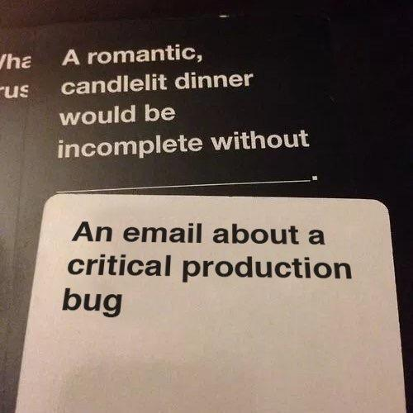
"Development" teams get something "working" then throw it to an "Operations" team who struggle to wrestle with the day-to-day running and support of it.
Software Scoped to Functional Reqs
No Resources once in Production
Deliverable ≠ Operable
@smileandeliver
Notes:
requirements of the system/software so narrowly scoped to get it doing what it needs to do so we can say it's done. Non-functional, operational requirements (e.g. monitoring/support/upgrades/decommissioning/data retention/cleanup etc.) get overlooked and/or aren't considered.
"Application Lifecycle Management" anyone?
All the time/effort/money/resources gets put in at the start of a "project", then when something is delivered, all the resources get taken away leaving the operational side (without a budget and with a bit of a train-wreck of a system/solution to support).
I've also seen this compounded by the assumption(s) that once something is built/released and in Production, that it's "done"/"working"/"delivering" and doesn't...
cost any more people/time/resource/money to support and will never have any problems

Slide 15
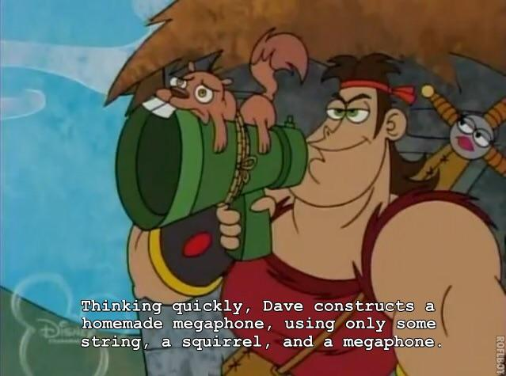
Complexity:
One of the greatest enemies of Operability
@smileandeliver
Notes:
Have we delivered the Requirements in the most efficient way? Is there a complicated and error prone switch we have to do in order to switch between live environments? Does a change in config require disruptive restarts? Do you have to do stuff manually?

Slide 16
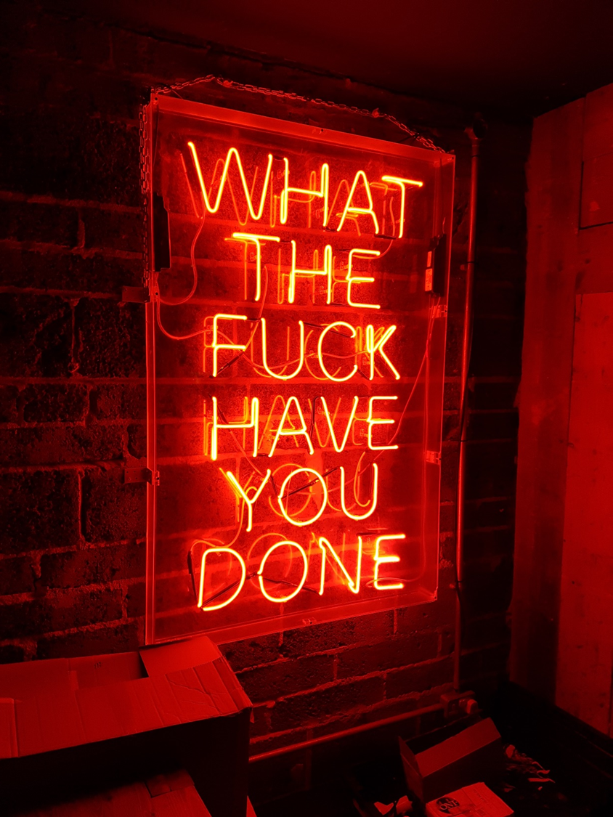
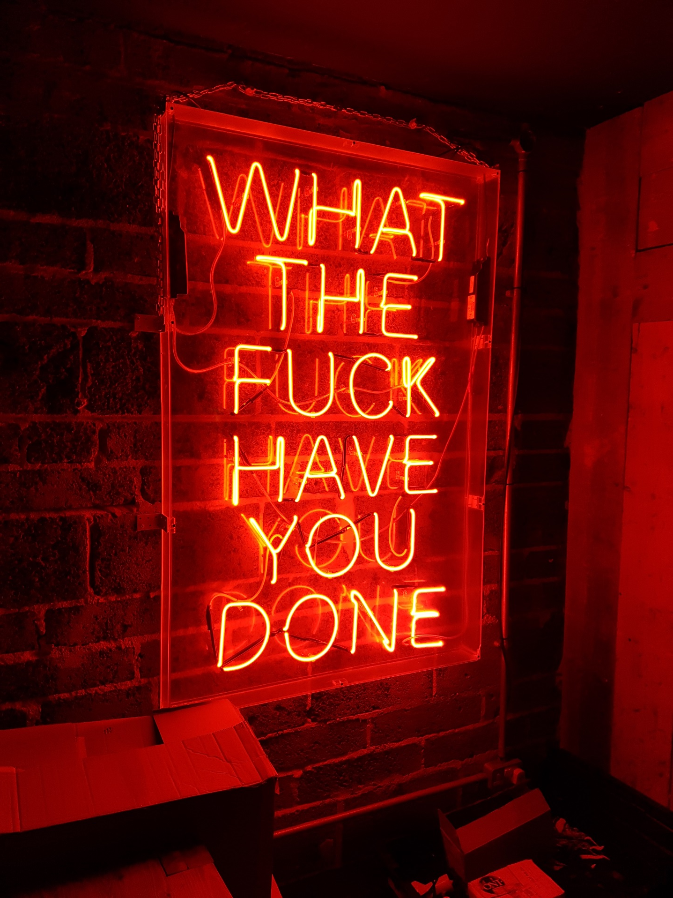
Do you know what just happened and why?
The Right Metrics
Sterile Environments
Access Auditing
Access Control
Diagnostics
@smileandeliver
Notes:
Metrics – are they telling you what the fuck is going on ? Do you have the information that says exactly what just happened? Are the environments so sterile that your tests in preprod are gonna be truly representative of Prod so that you can troubleshoot without touching Live?

Slide 17


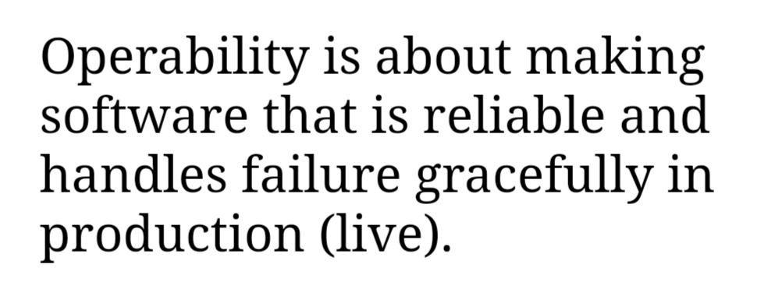
Operability
Your Ops Teams are now the Customer
Deployment Engineers
Ops Engineers
Customer Support
Configuration Team
@smileandeliver
Notes:
I’m going to tell you about some of the ideals of operability from the perspective of someone who’s currently a deployment engineer, and who in the past has been at the operational sharp end. I know that you as test professionals are the ones to work out exacly HOW this stuff can be tested

Slide 18
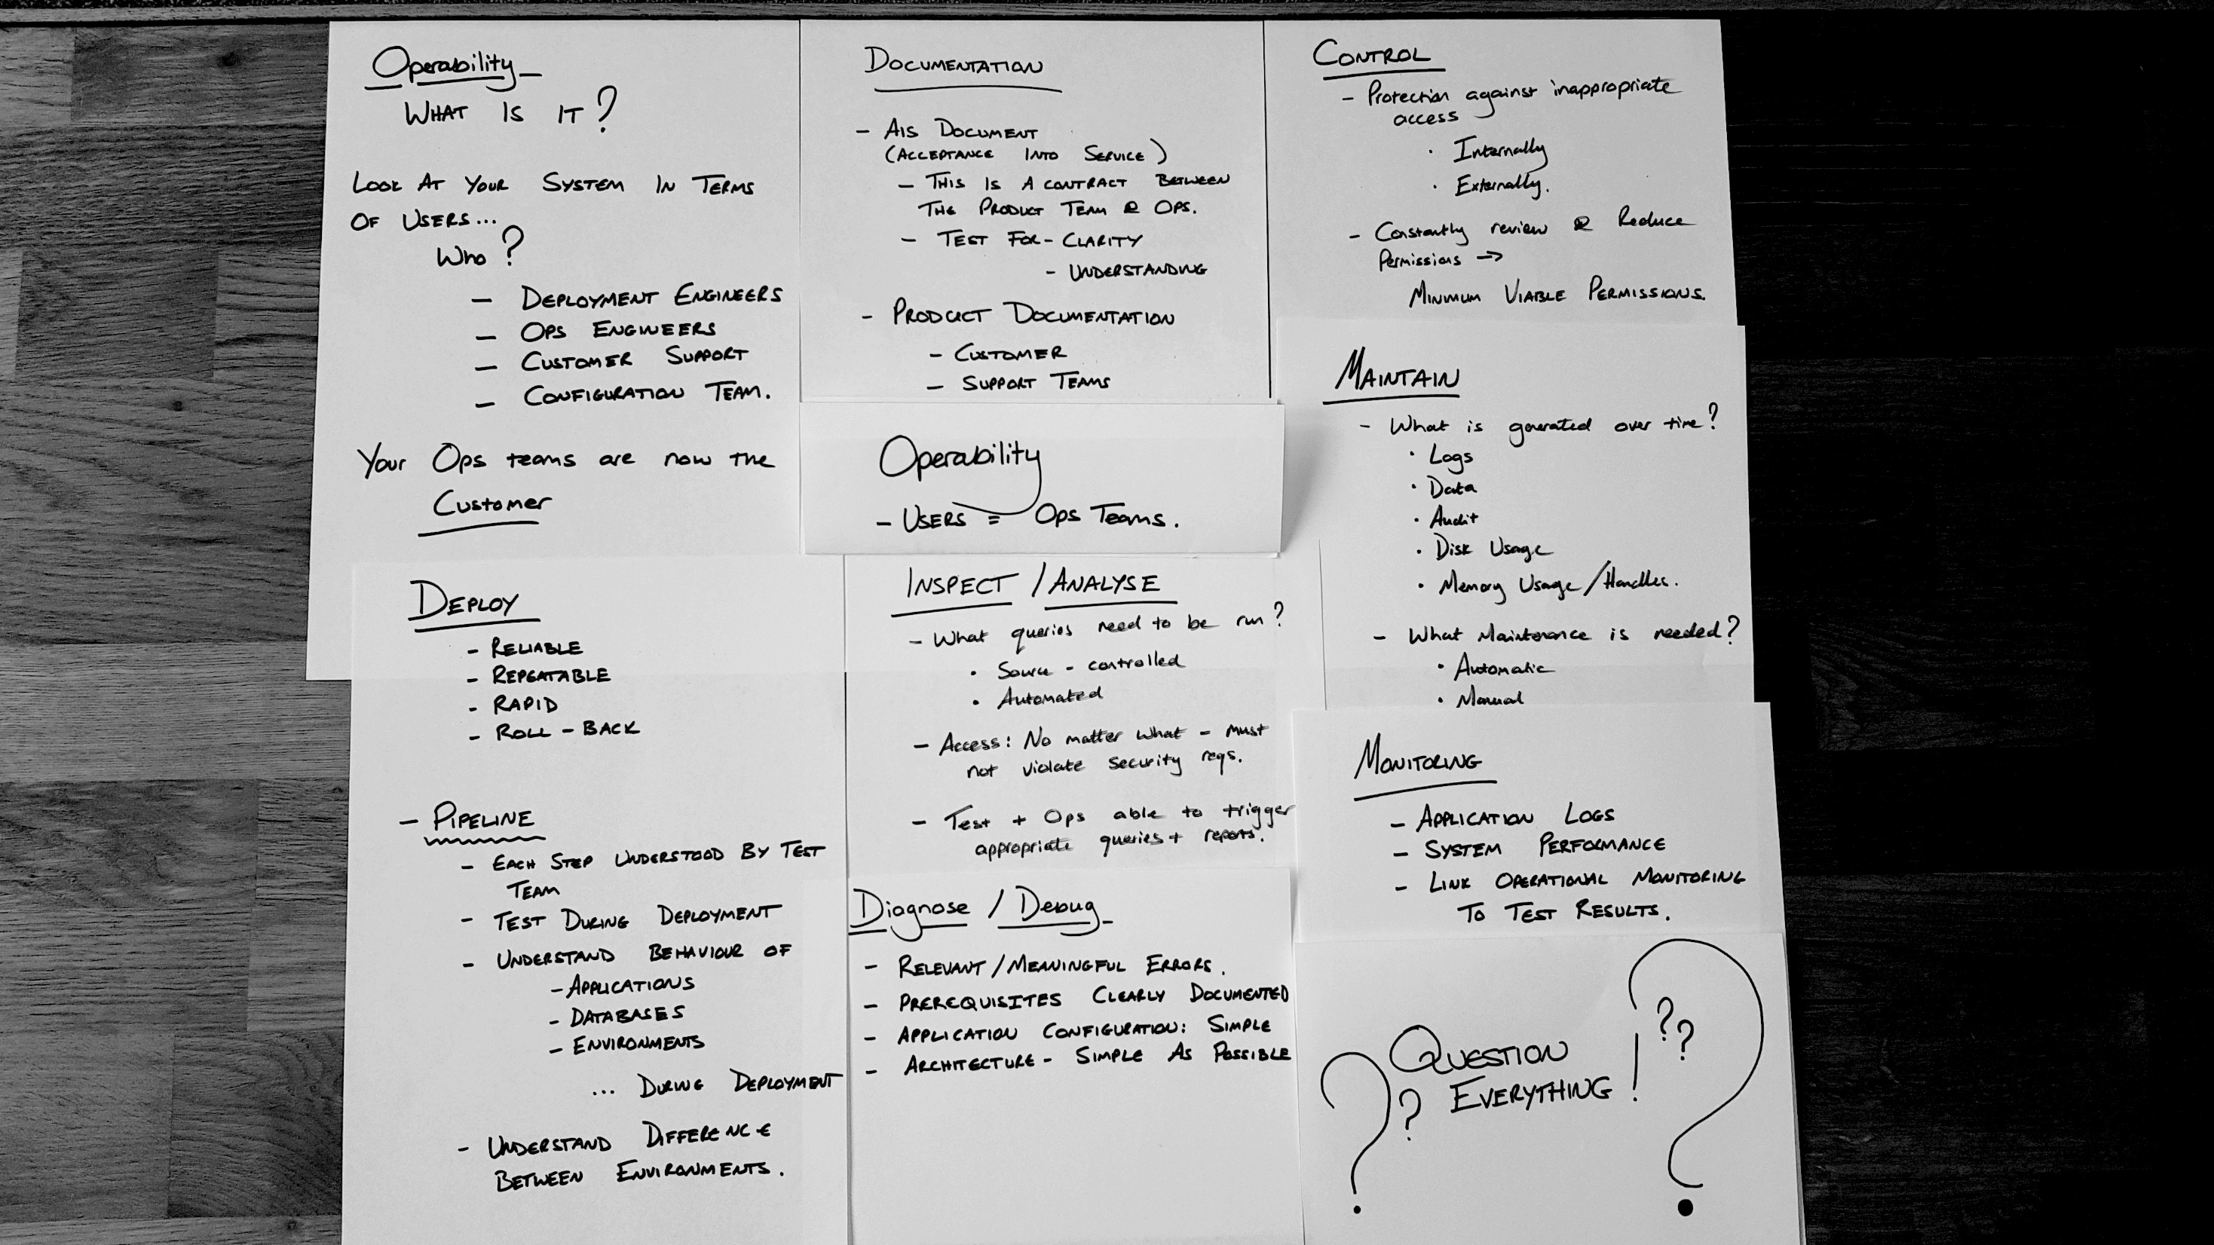
Notes:
Started to map out what Operability is from a ton of different sources

Slide 19

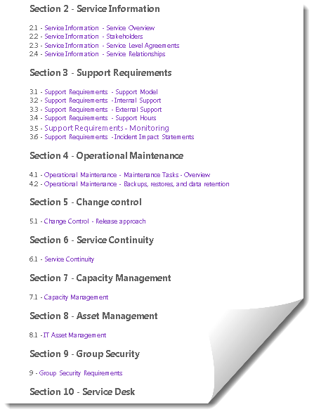
Operability Documentation
AIS DOCUMENT
(Acceptance into Service)
Operability Contract between All teams
Clarity
Understanding
Completeness
PRODUCT DOCUMENTATION
Customer Facing
Support
Architecture
Notes:
· Recovery Time Objective (RTO)
· Recovery Point Objective (RPO)
· Minimum Recovery Operating Level (MROL)

Slide 20
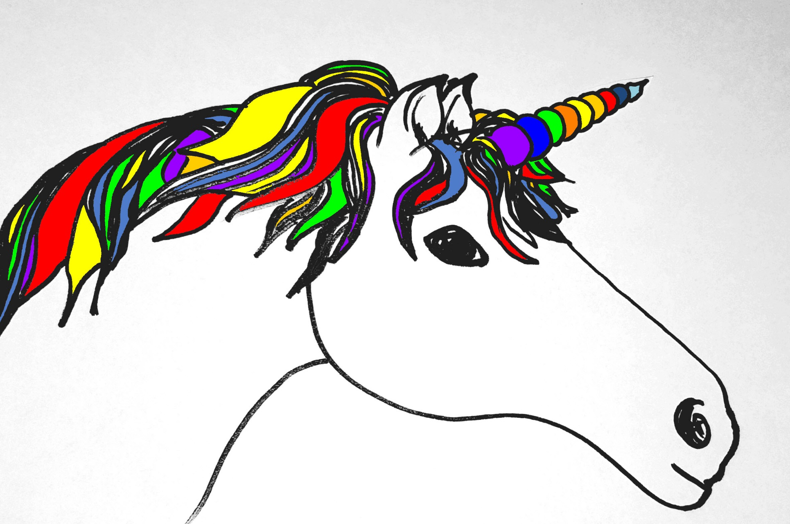

Deployability
Reliable
Repeatable
Rapid
Roll-back
PIPELINES
Each step understood
Applications / Services
Databases
Environments
Walking Skeleton
Test During Deployment

Slide 21

Maintainability
What builds up over time?
Logs
Data
Audit
Memory Usage
What Maintenance is Needed?
Automatic
Manual
@smileandeliver

Slide 22
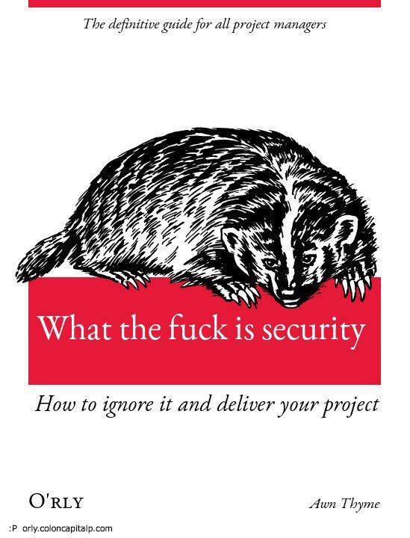
Control
Protection against inappropriate access
Internally
Externally
Regularly Review and Reduce Permissions
Minimum Viable Permissions
Access via Controlled System
Access Audit

Slide 23

Monitoring
Application Logs
System Performance
Link Ops Monitoring to Test Results
Inspect/Analyse
What queries need to be run?
Source-Controlled
Automated
Access: Must comply with Security Reqs
Test & Ops Teams able to trigger Appropriate Queries & Reports
Diagnose/Debug
Relevant / Meaningful Errors
Prerequisites Clearly Documented
Simple:
Application Configuration
Architecture
@smileandeliver

Slide 24
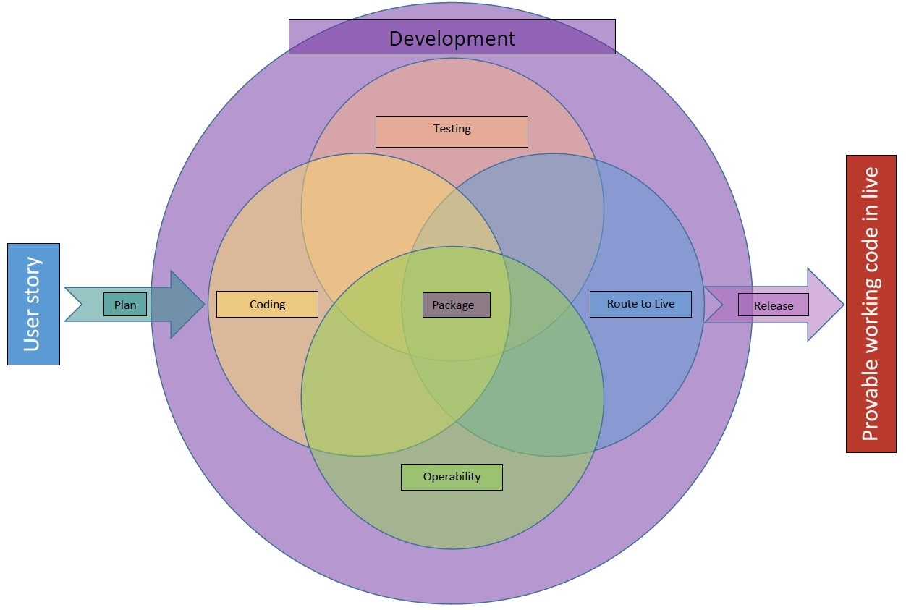

Slide 25

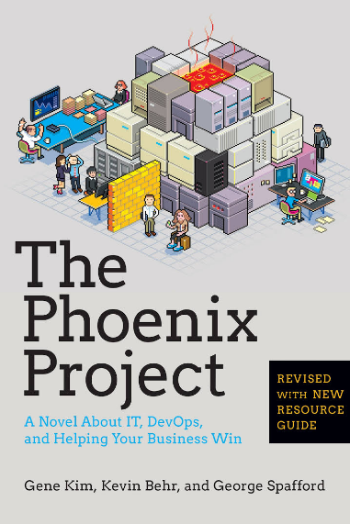
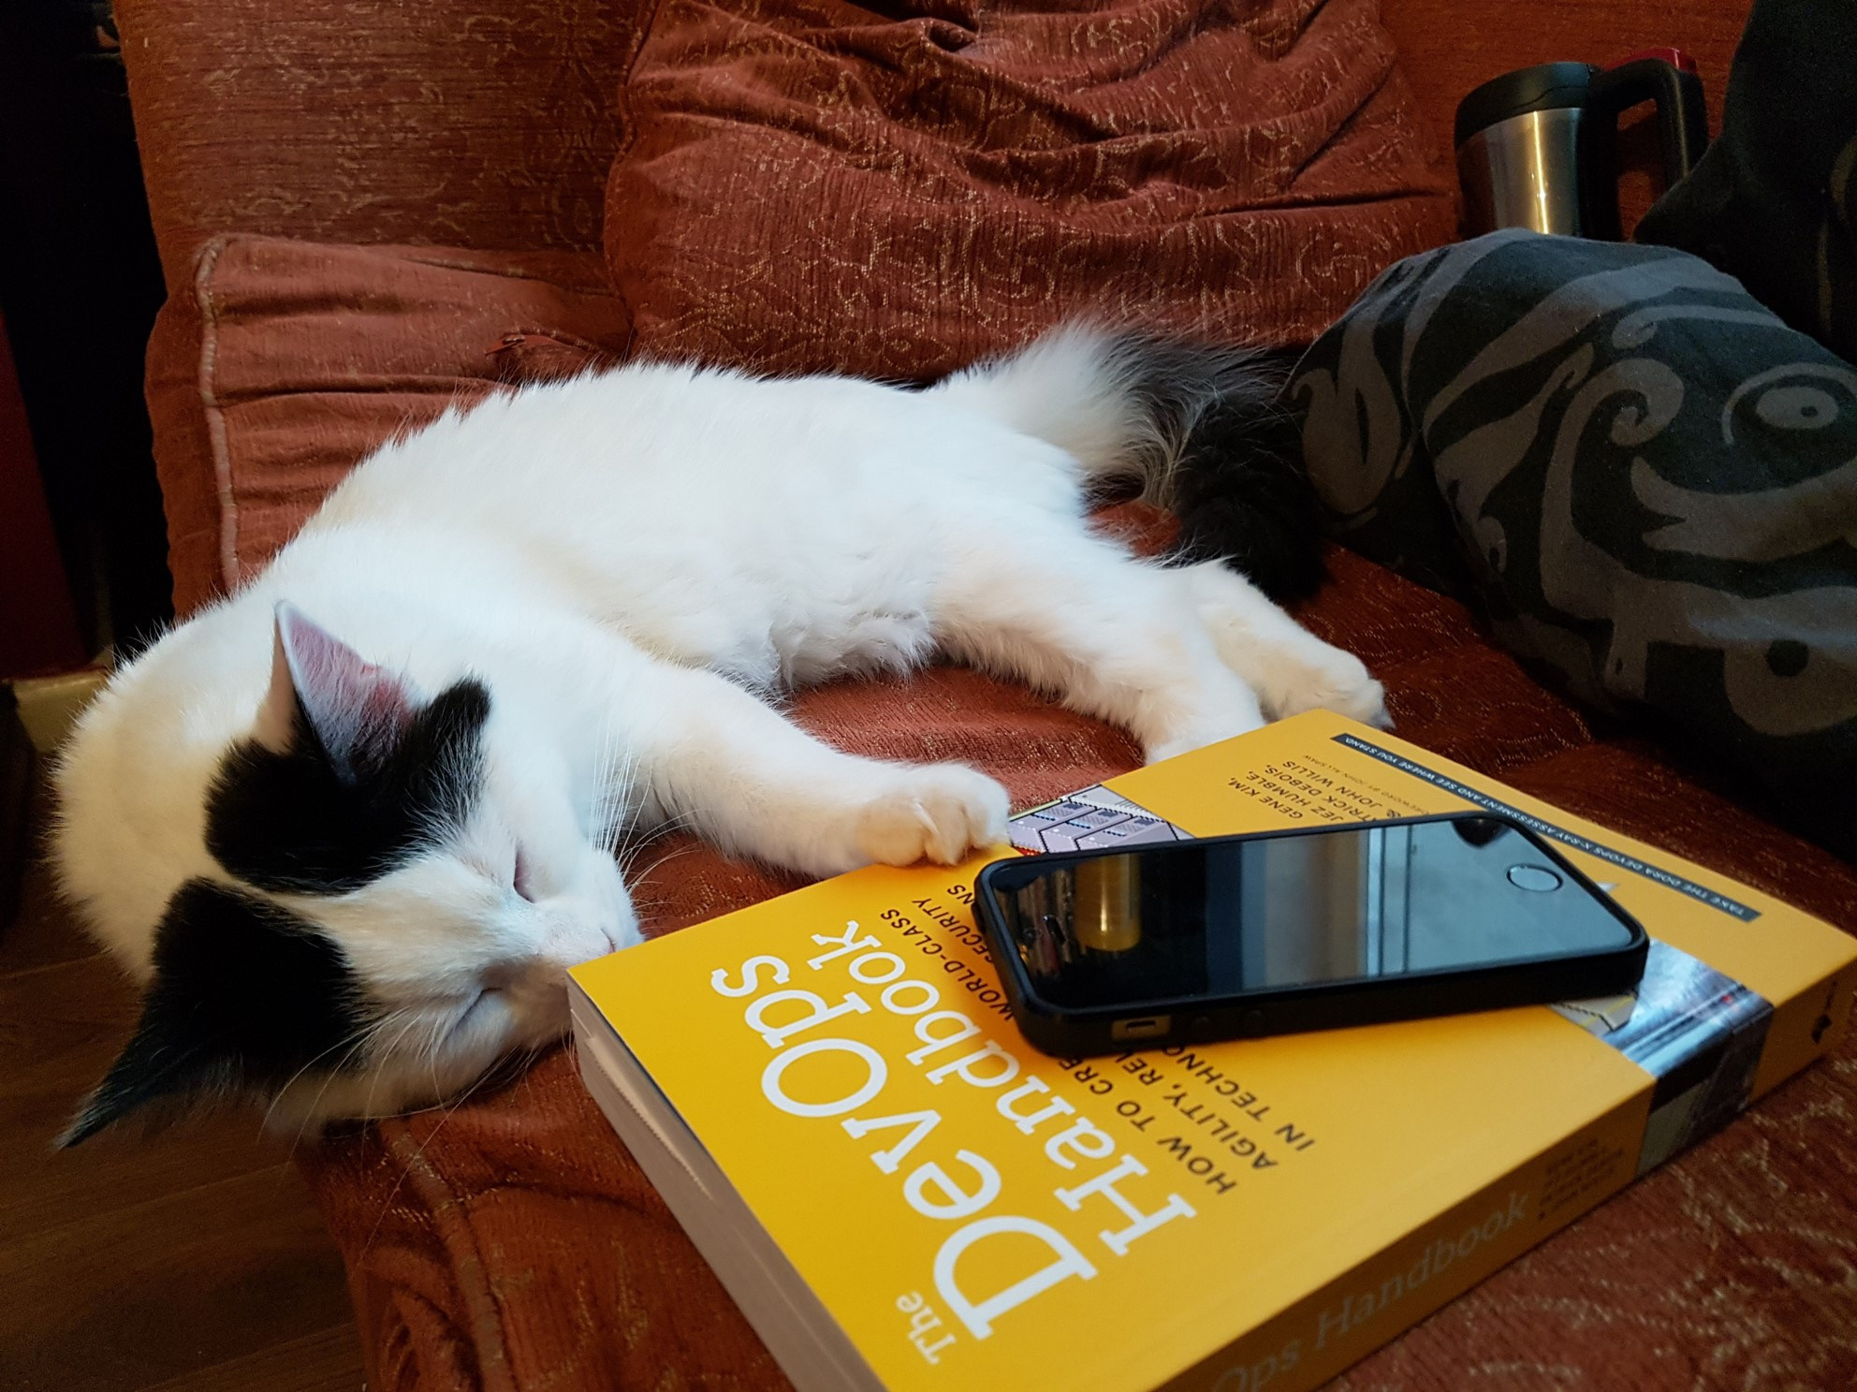
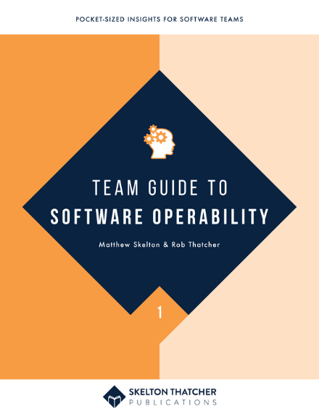
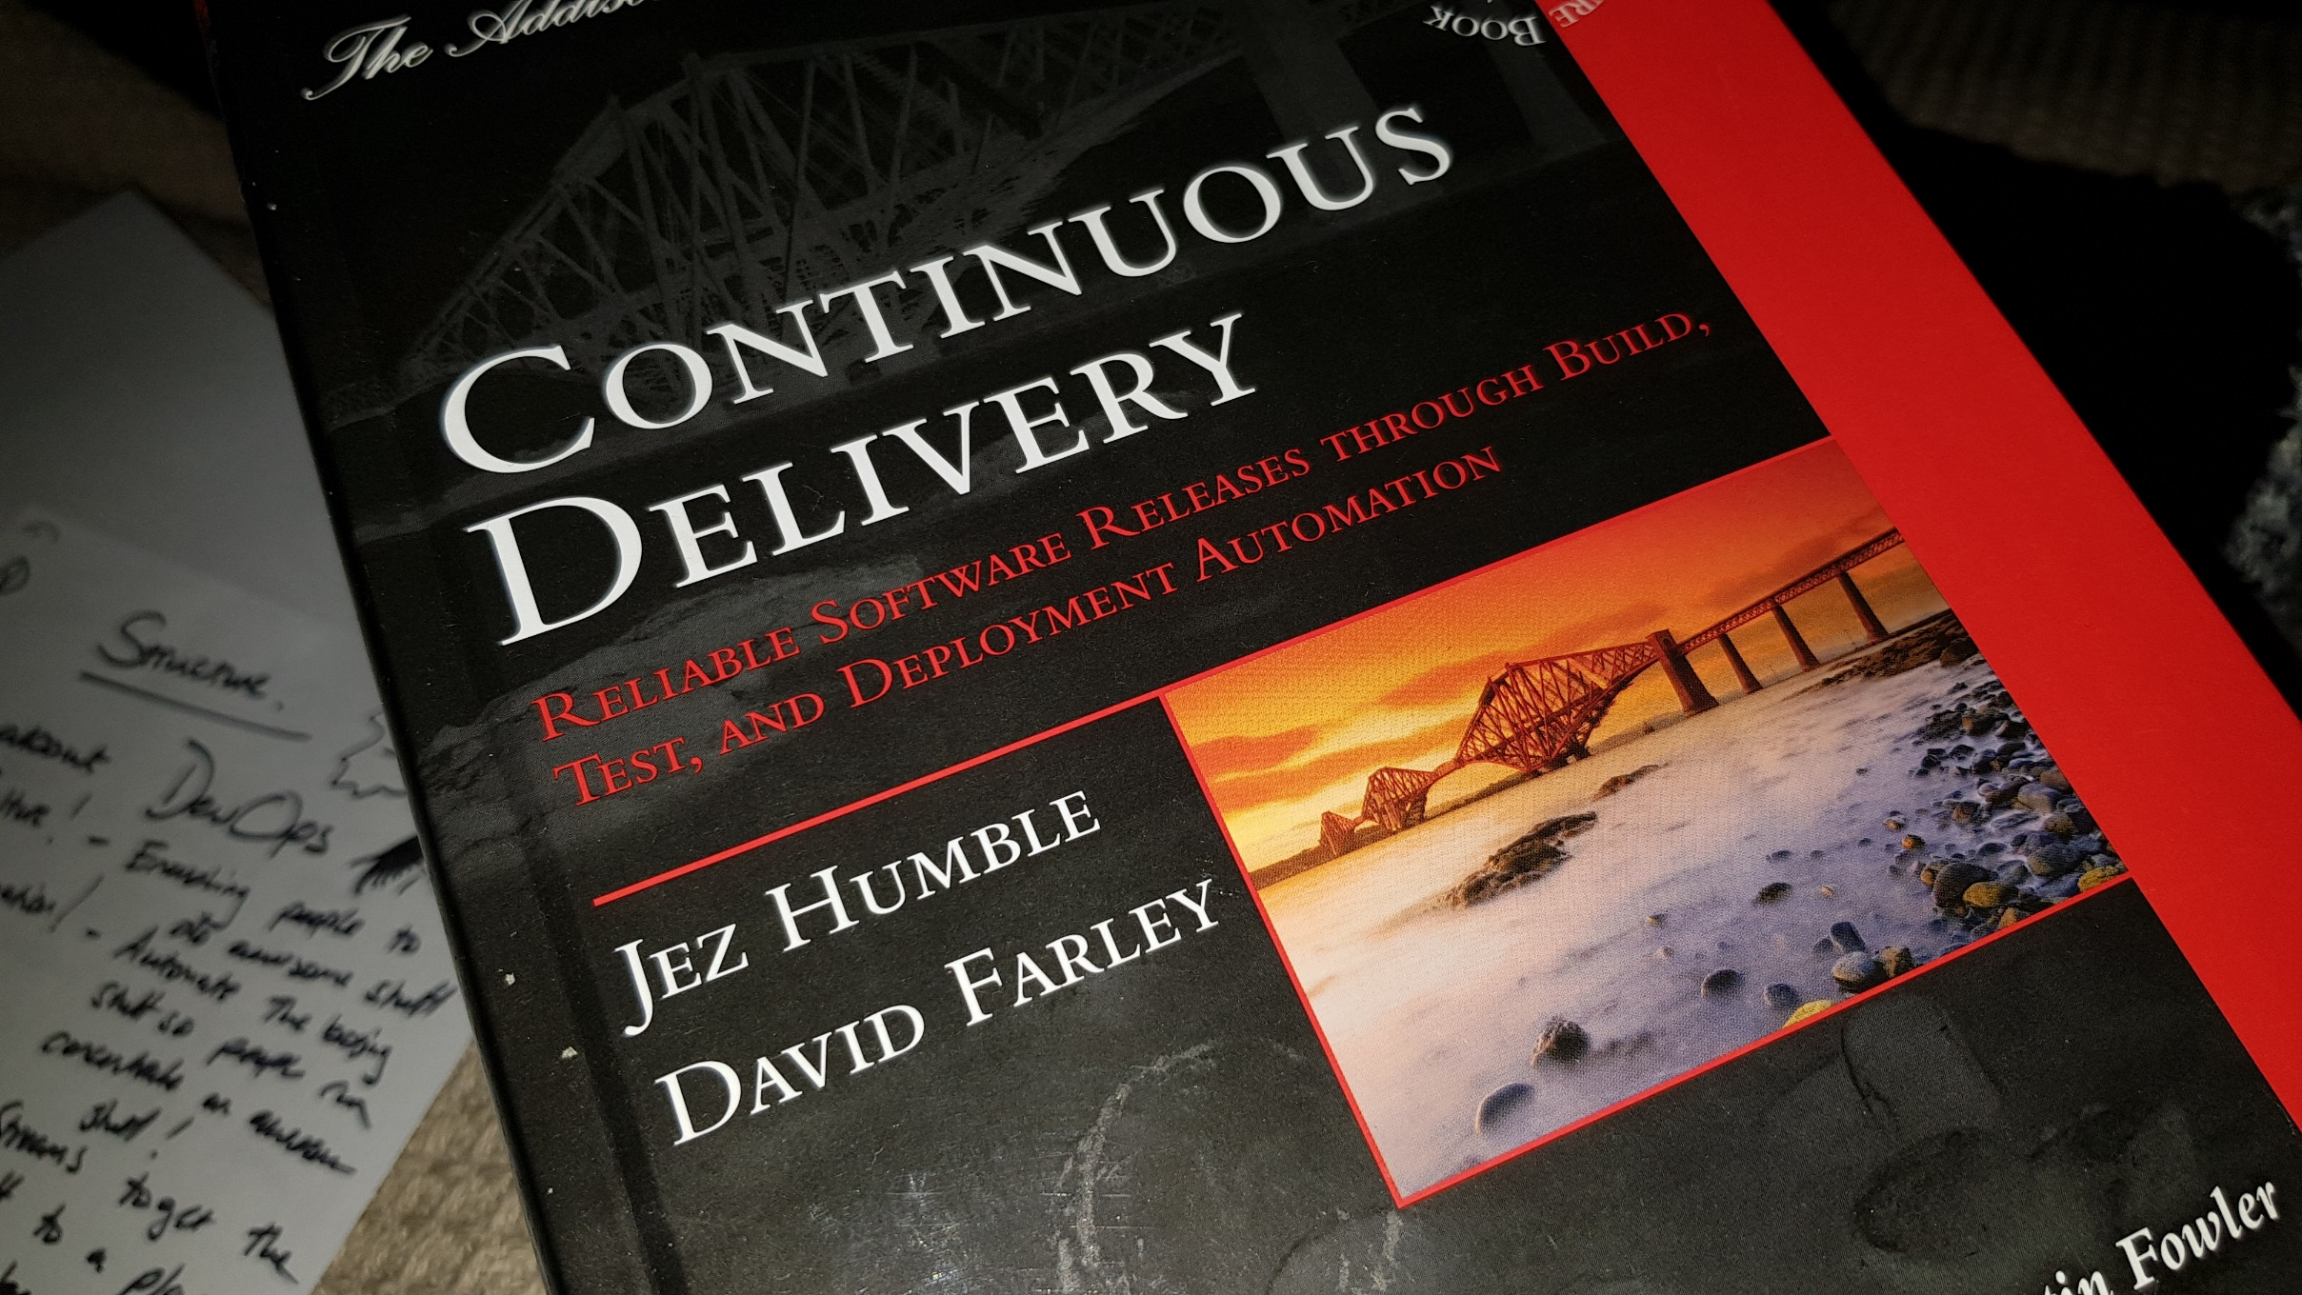
@smileandeliver
Notes:
Insert credits here particularly Continuous Delivery, DevOps Handbook, Phoenix Project and Software Operability Manuel Pais and Matthew Skelton

Slide 26

Header
@smileandeliver
https://github.com/smileandeliver/
Notes:
Thank you and please come forward with any questions

